Slide 1







Wi-Fi 2.4GHz
Attacking Tools
WIFUSION | SERIALADAPT-HUNT | WIFI-RHAPSODY

Slide 2
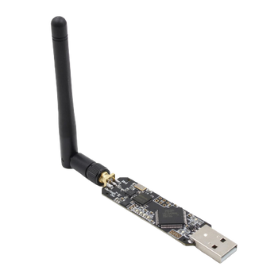

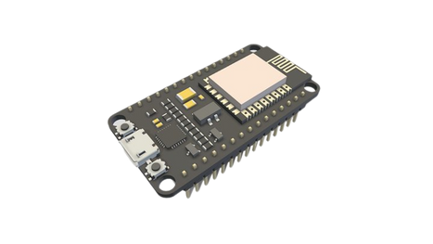


AGENDA
WIFUSION
SERIALADAPT-HUNT
WIFI RHAPSODY
WiFi Hacking Watch
WiFi Adapter
WiFi Monitoring Device

Slide 3
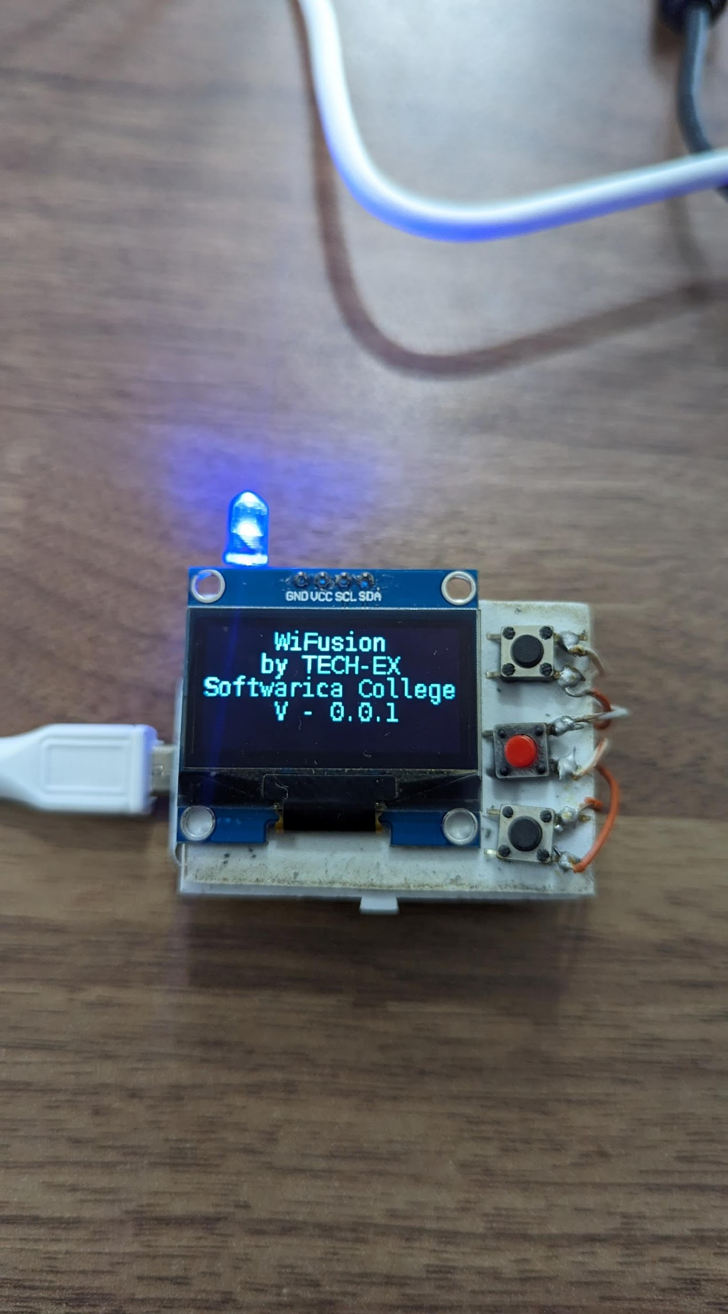
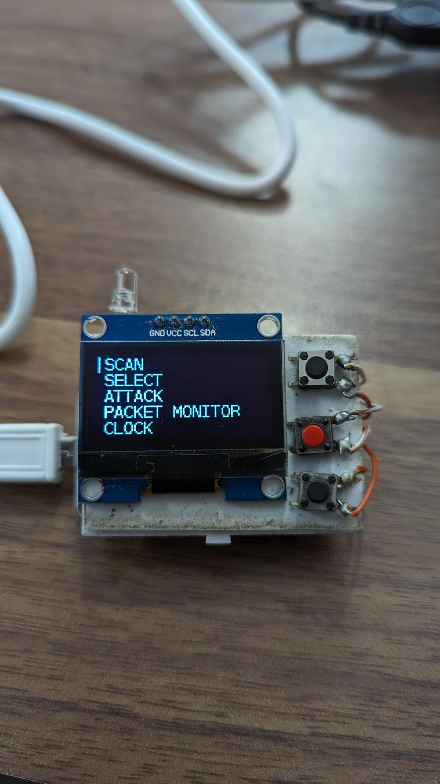
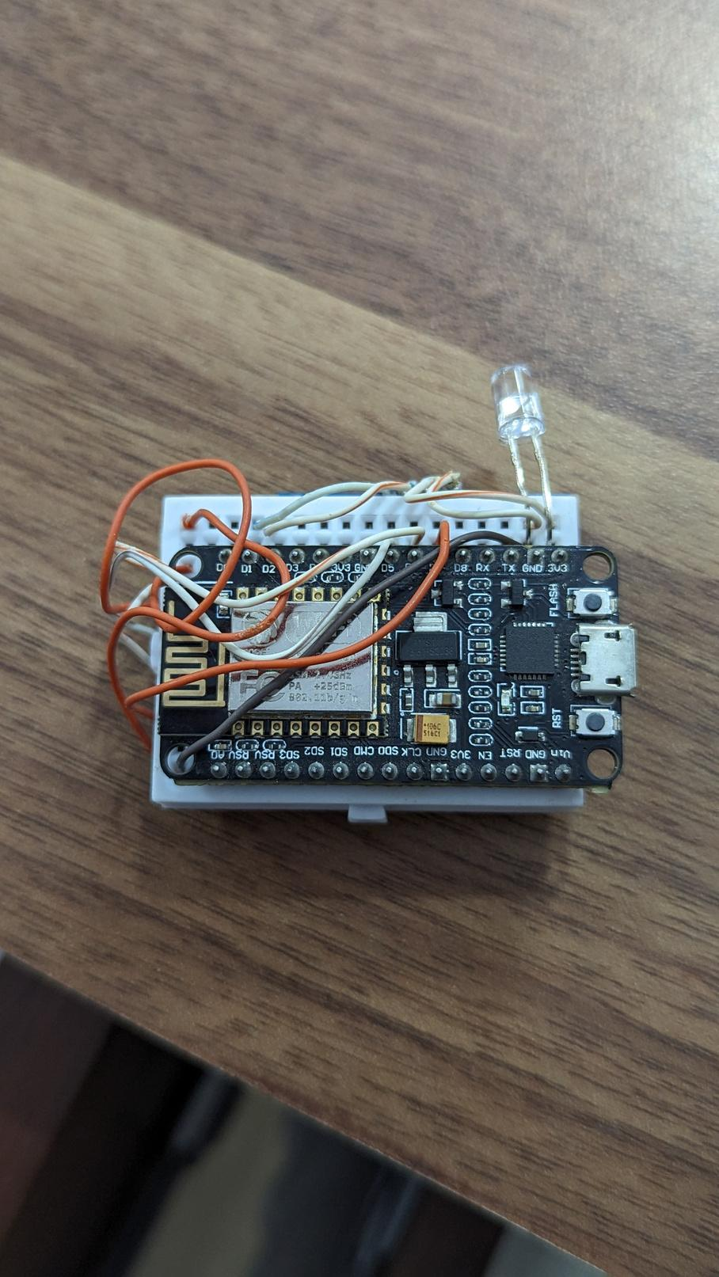
WIFUSION
WiFsuion is a device using ESP32, SH1106, push buttons, and a LED for wireless attacks. It scans nearby access points and devices and performs deauthentication, beacon, and probe attacks with options to target multiple APs or devices. It also includes packet monitoring for efficient attack selection.

Slide 4
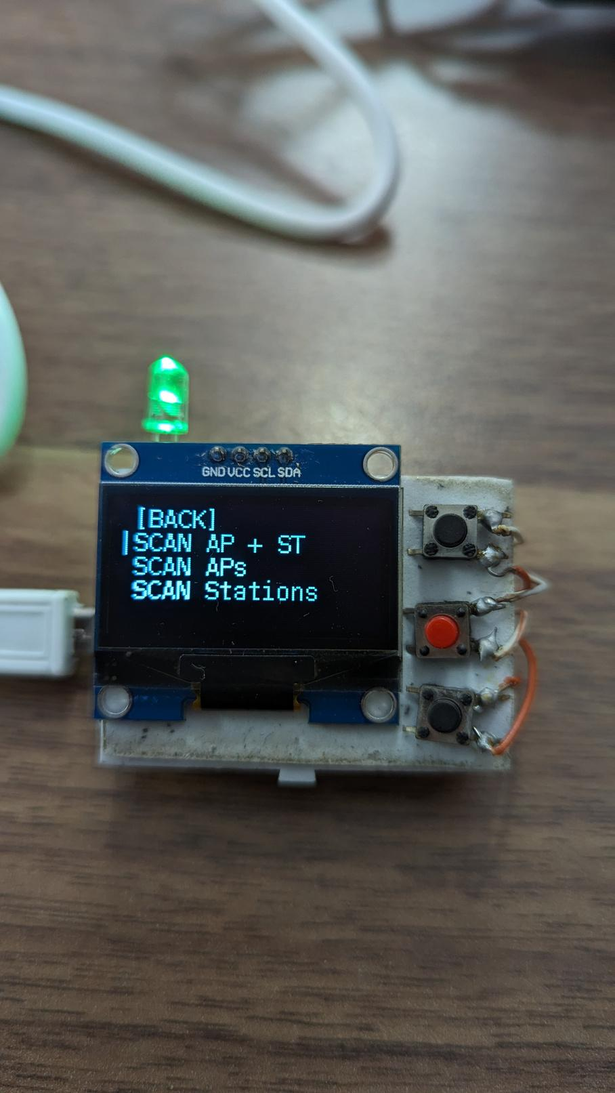
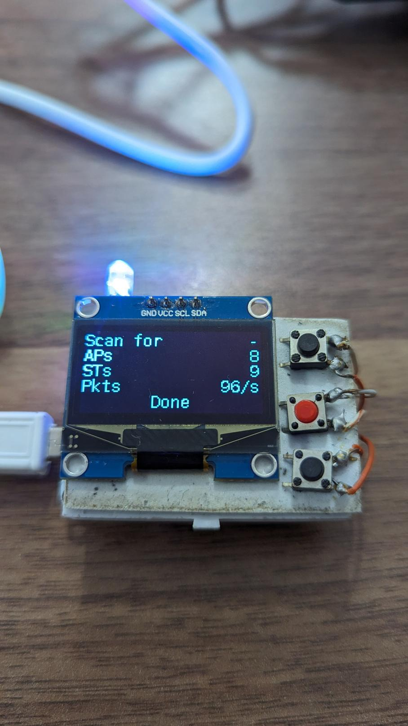
WiFusion - Scanning
In the scan menu, WiFsuion offers three types of scans: nearby Wi-Fi Access Points (APs), Wi-Fi Client Stations (STs), or a combined scan for both APs and STs.

Slide 5
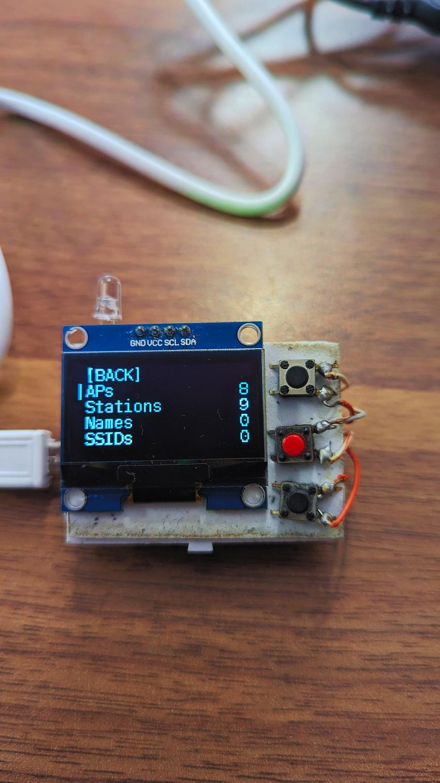
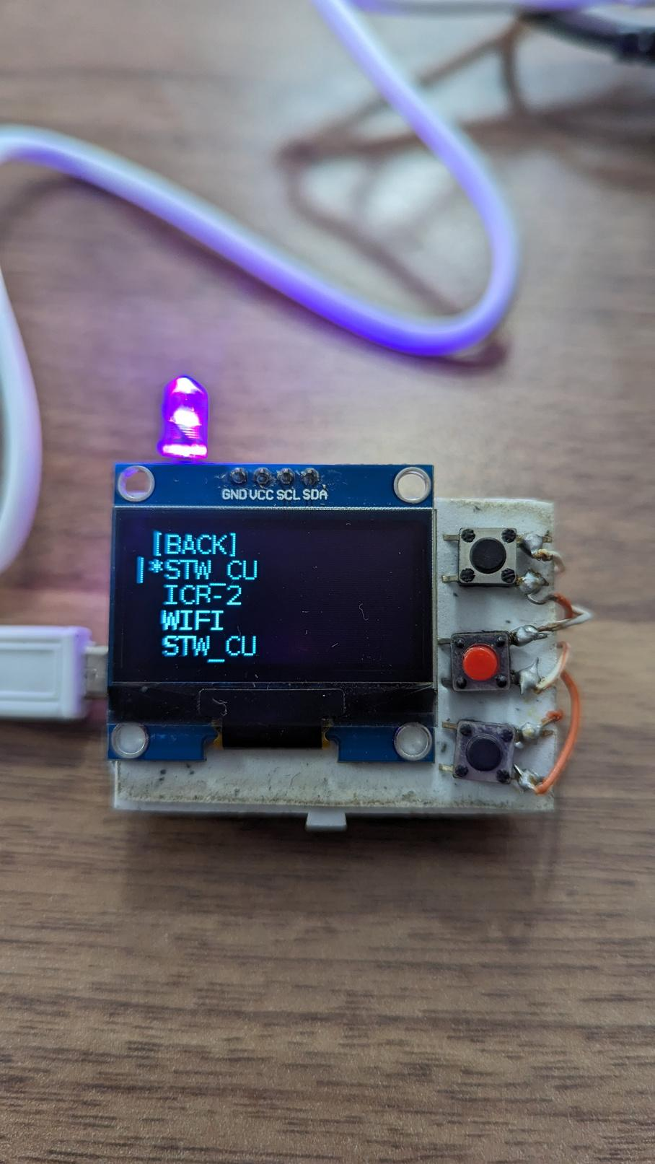
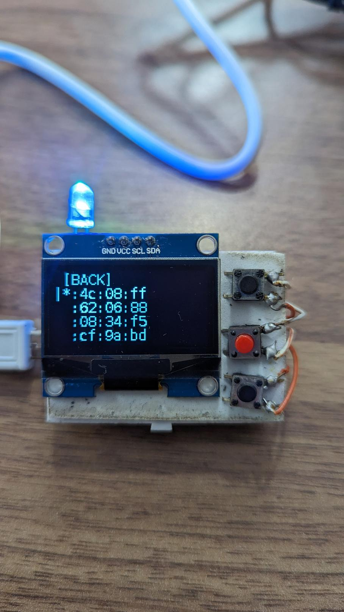
WiFusion - Select
In the select menu, users can choose attack targets by accessing the scanned WiFi Access Points (APs) and WiFi Client Stations (STs). Additionally, specific SSIDs can be selected for a beacon attack or saved devices under Names can be targeted for various attacks.

Slide 6
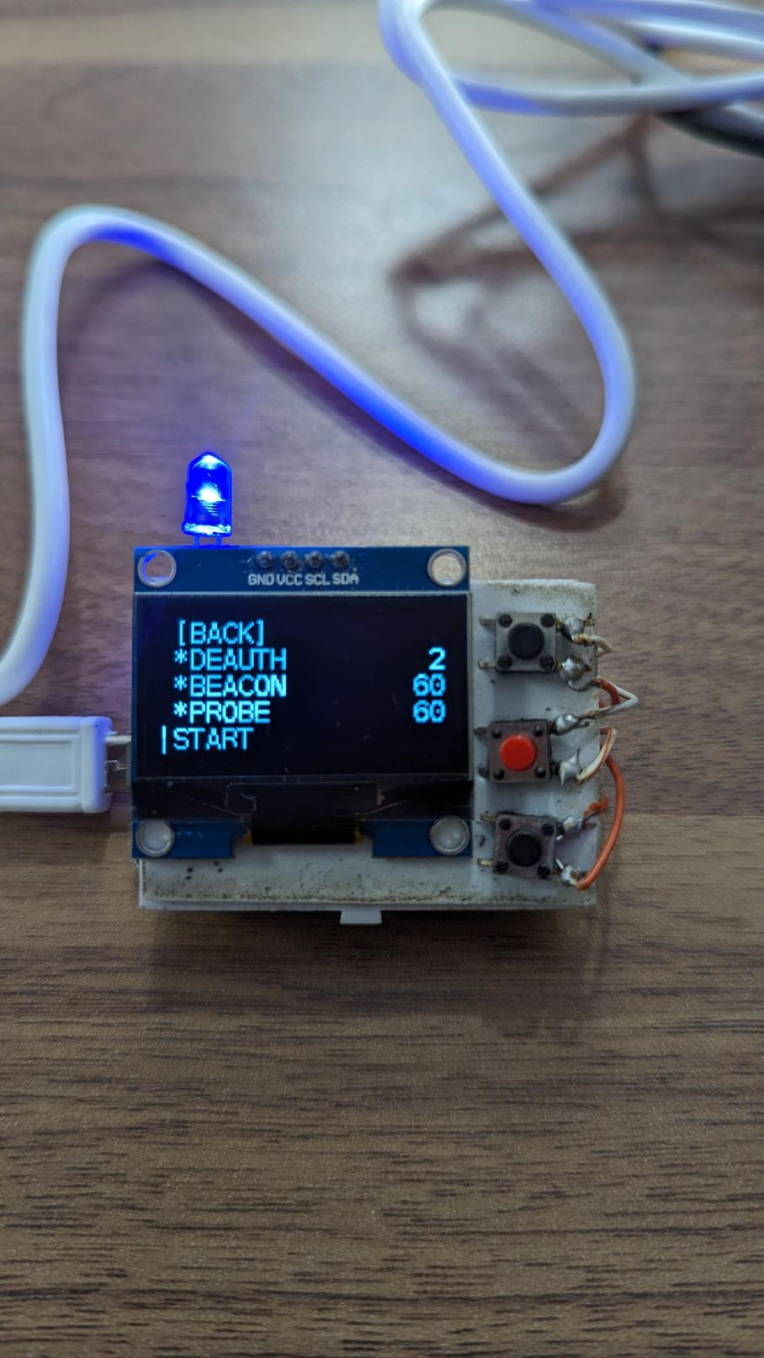

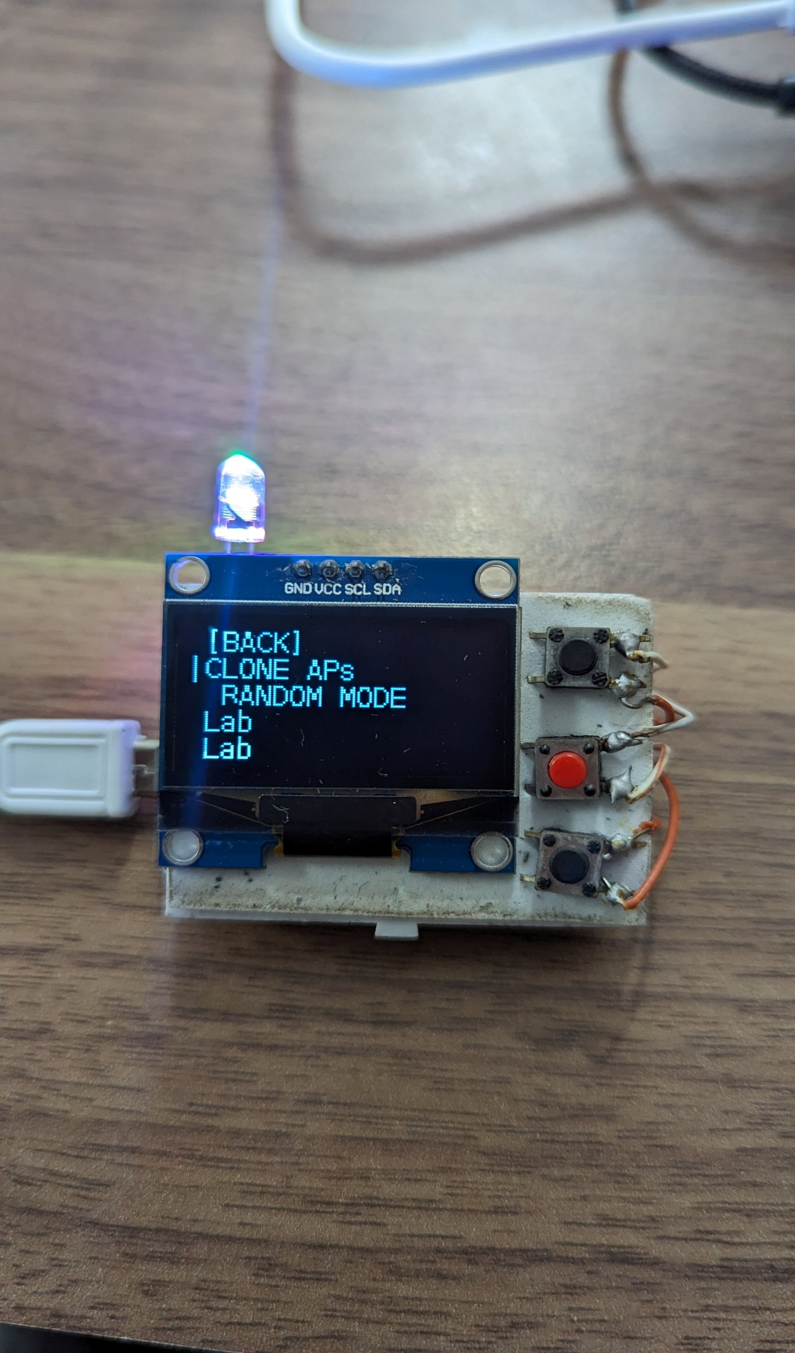
WiFusion - Attack
On the attack page, users can execute different WiFi attacks:
DEAUTH: Disconnects selected devices (APs or STs) through deauthentication.
BEACON: Floods the target with fake SSIDs using beacon frames.
PROBE: Floods the target with probe request frames, disrupting connected devices.

Slide 7
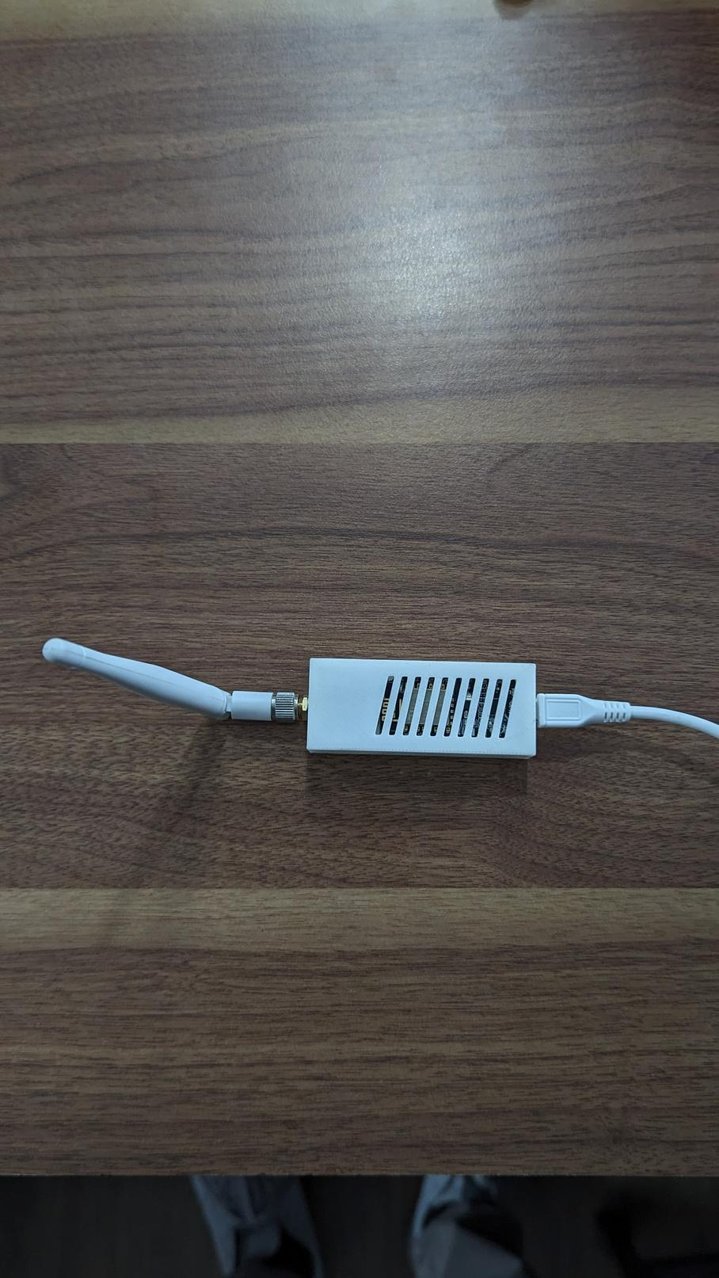
SERIALADAPT-HUNT
WiFusion and SerialAdapt-Hunt share common functionalities like Deauth, Beacon, and Probe attacks, as well as network scanning for access points and clients. However, they differ in control methods; WiFusion uses a display and buttons, while SerialAdapt-Hunt connects via USB and is controlled through a serial terminal. SerialAdapt-Hunt prioritizes a powerful command-line interface (CLI) to fully utilize hardware capabilities like CPU, memory, and the WiFi transceiver.

Slide 8
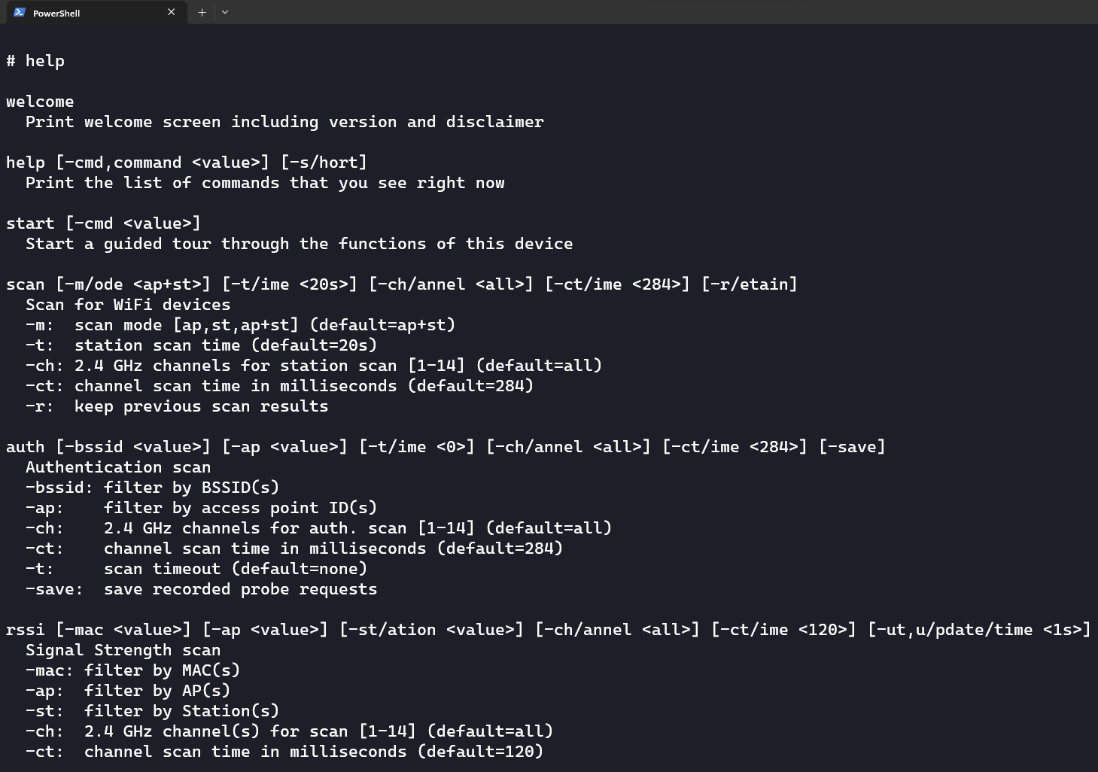
SerialAdapt-Hunt
Terminal
SerialAdapt-Hunt provides a user-friendly terminal interface, offering a simple manual or step-by-step guide to navigate and initiate attacks efficiently.

Slide 9
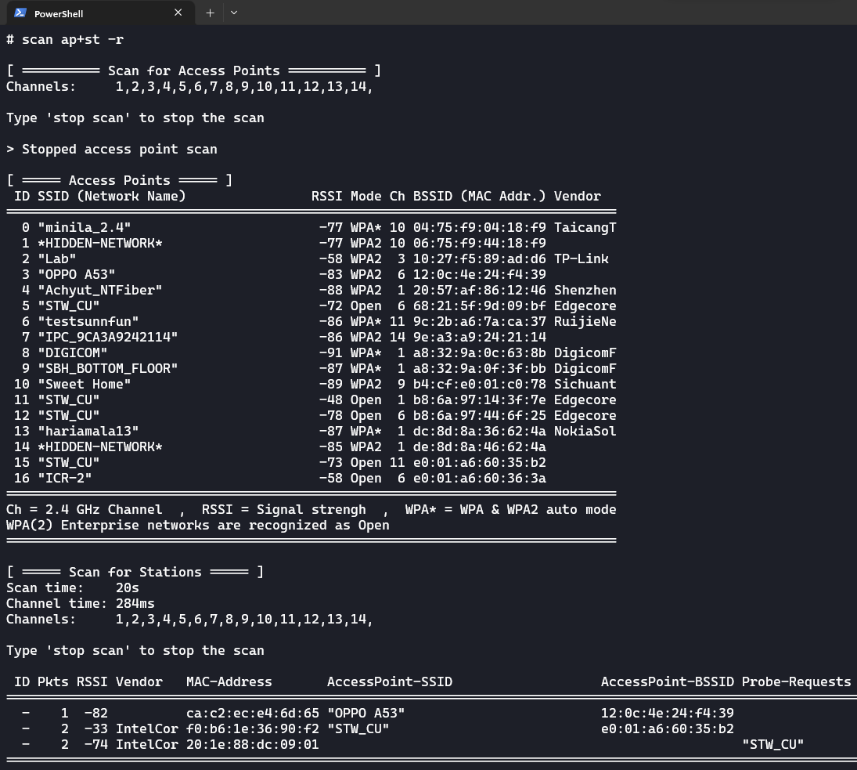
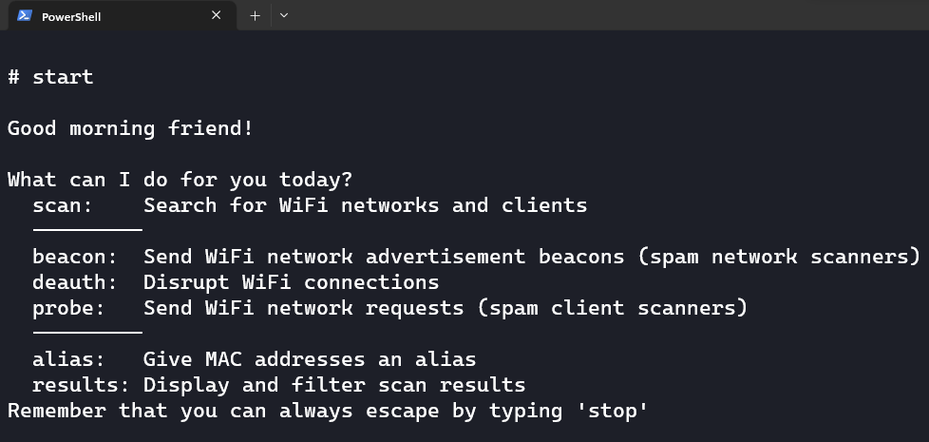
SerialAdapt-Hunt
Scanning
On the scanning side, SerialAdapt-Hunt provides insights into probe requests from nearby devices, revealing their previously connected networks. Furthermore, users can view the MAC addresses of devices attempting to connect to networks advertised through the beacon attack. The option to alias MAC addresses adds convenience in recognizing known devices. Furthermore, all the results can be saved for future use. These comprehensive features make SerialAdapt-Hunt a powerful tool for efficient WiFi analysis and attacks.

Slide 10















THE MAIN IDEA
SSID: OFFICE
MAC: aa:bb:cc:dd:ee:ff
Officeadmin.com
1.1.1.1
DNS Response
Officeadmin.com --> 2.2.2.2
Type: Deauthentication
Subtype: Disassociation
SSID: OFFICE
MAC: aa:bb:cc:dd:ee:ff
Username
Password
Admin
Admin
WiFusion
Officeadmin.com
Officeadmin.com
DNS Query
Officeadmin.com
2.2.2.2

Slide 11
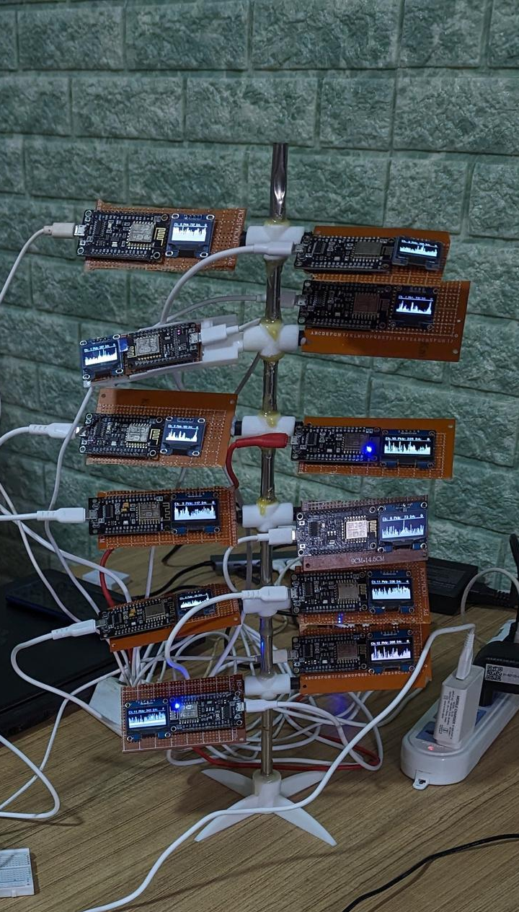








WIFI RHAPSODY
WiFiRaphsody is a monitoring device that efficiently captures and stores packets on the 2.4GHz band across all 14 channels simultaneously, providing comprehensive coverage. Its valuable deauthentication packet detection feature allows students to identify potential threats from wireless networks. The device is designed as a cost-effective alternative to the Wifi Cactus, utilizing 14 ESP32 boards with OLED screens and a storage device (like an SD card) to display and log the traffic from the 2.4GHz channels. All captured data is saved in .pcap format, ensuring convenient and compatible storage for further analysis and research.
/ Ch1 / 1.pcap ........ n.pcap
/ Ch2 / 1.pcap ........ n.pcap
/ Ch3 / 1.pcap ........ n.pcap
/ Ch4 / 1.pcap ........ n.pcap
.
.
.
.
.
.
.
/ Ch14 / 1.pcap ........ n.pcap
Probes
Beacons
Authentications

Slide 12
Thank you!

